Slide 1

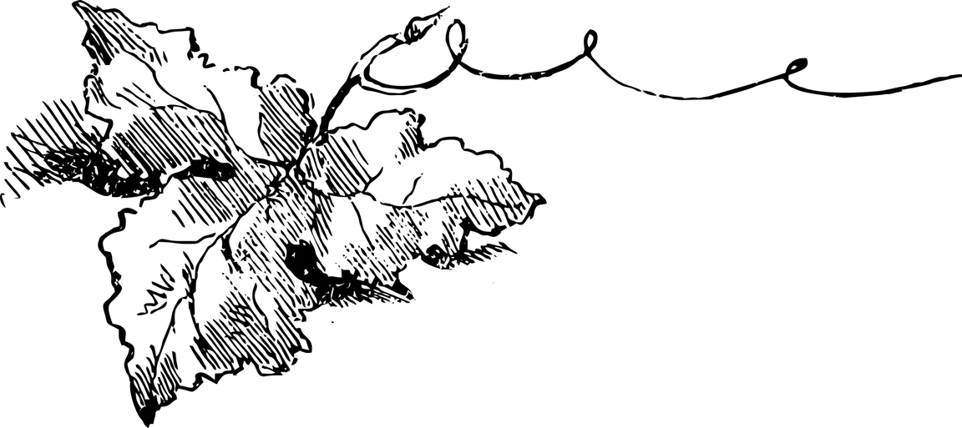
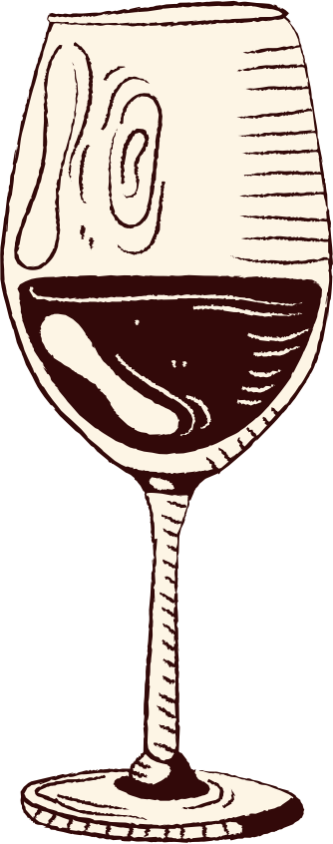

WINE
QUALITY
PREDICTION
~ Akshar Kumar Hemachandra ~

Slide 2


AGENDA
Introduction
Data exploration & Visualization
Decision Trees
Logistic Regression
Final Takeaways

Slide 3
INTRODUCTION

Slide 4

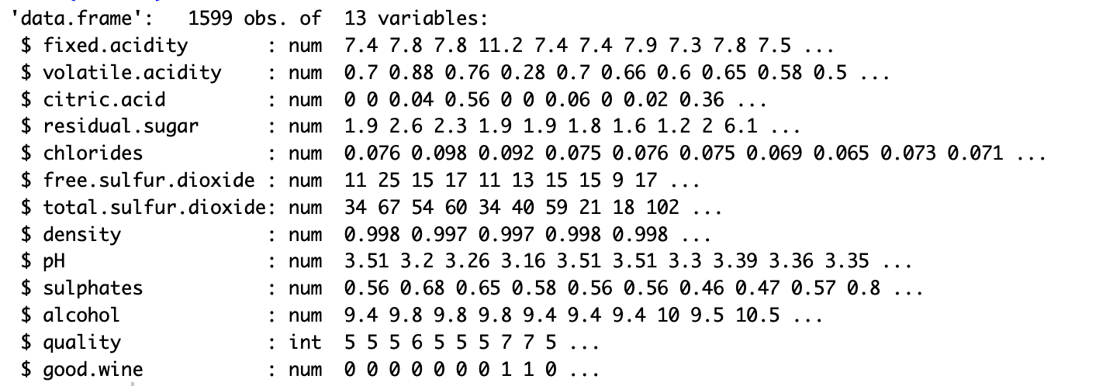
Introduction
To determine how each physiochemical variable determines the quality of Red Wine Used machine learning to determine which physiochemical properties make a wine 'good’!
Dataset: Kaggle
Created a variable indicating if a wine is good or bad using

Slide 5



Variables
Residual sugar (g/L)
Alcohol (vol/%)
Volatile Acidity (g/L)
Density (g/cm³)
Fixed Acidity (g/L)
Sulphates (g/L)
Citric Acid (g/L)
Chlorides (g/L)
Total Sulphur Dioxide (mg/L)
pH
Free Sulphur Dioxide (mg/L)
Acidic
Neutral
Basic
1 | 2 | 3 | 4 | 5 | 6 | 7 | 8 | 9 | 10 | 11 | 12 | 13 | 14
Wine

Slide 6
Variable Description
Fixed acidity (g/L): This measures the non-volatile acidity of the wine. Fixed acidity influences the wine's flavor and aging potential.
Volatile acidity (g/L): This measures the concentration of volatile acids, primarily acetic acid, in the wine.
Citric acid (g/L): This measures the amount of citric acid, another natural component of grape juice, Citric acid contributes to the wine's tartness and freshness
Residual sugar (g/L): This measures the unfermented sugar remaining in the wine after fermentation. residual sugar plays a crucial role in determining the sweetness of the wine
Chlorides (g/L):This measures the concentration of chloride salts, primarily sodium chloride, in the wine.
Free sulfur dioxide (mg/L) Sulfur dioxide is a common preservative used to prevent wine spoilage and oxidation, but excessive levels can impart a pungent, sulfurous odor and taste.
Total sulfur dioxide (mg/L): This measures the total amount of sulfur dioxide
Density (g/cm³): This measures the mass per unit volume of the wine.
Sulphates (g/L): This measures the concentration of sulfate salts in wine
Alcohol (volume percentage): This measures the percentage of alcohol by volume in the wine.

Slide 7

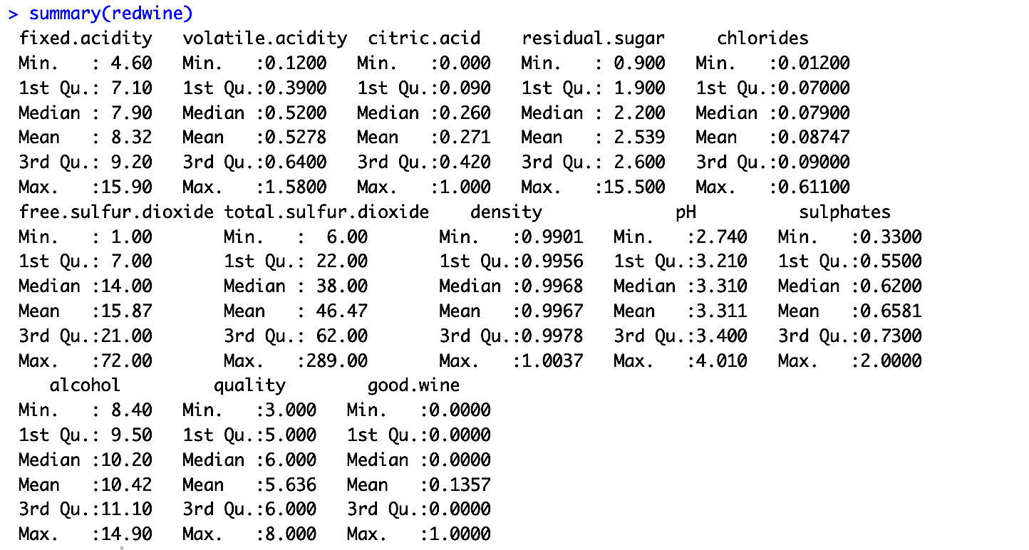

Summary

Slide 8
VISUALIZATION

Slide 9
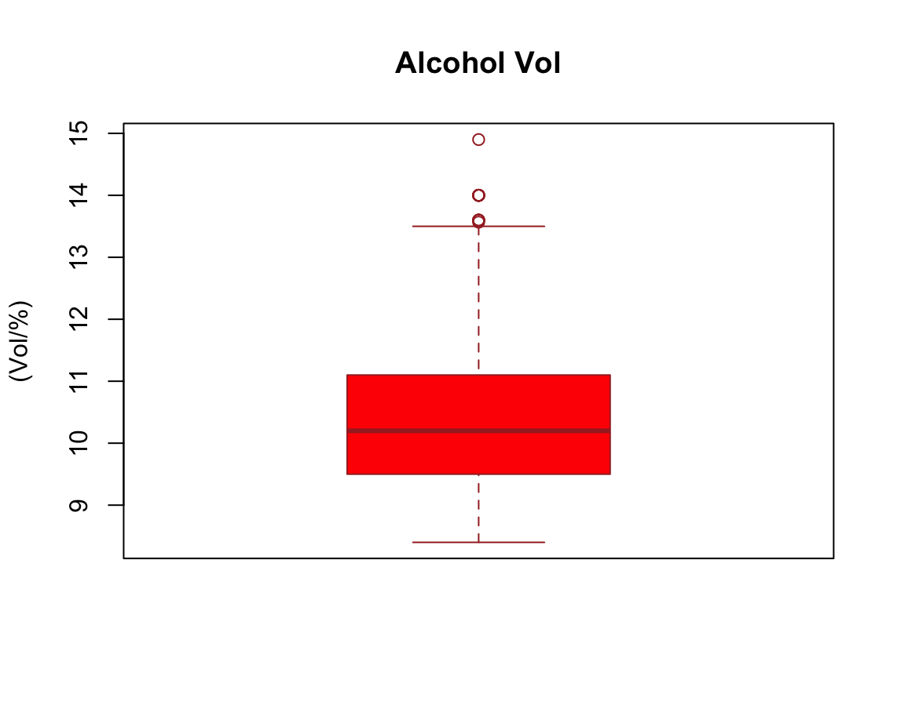
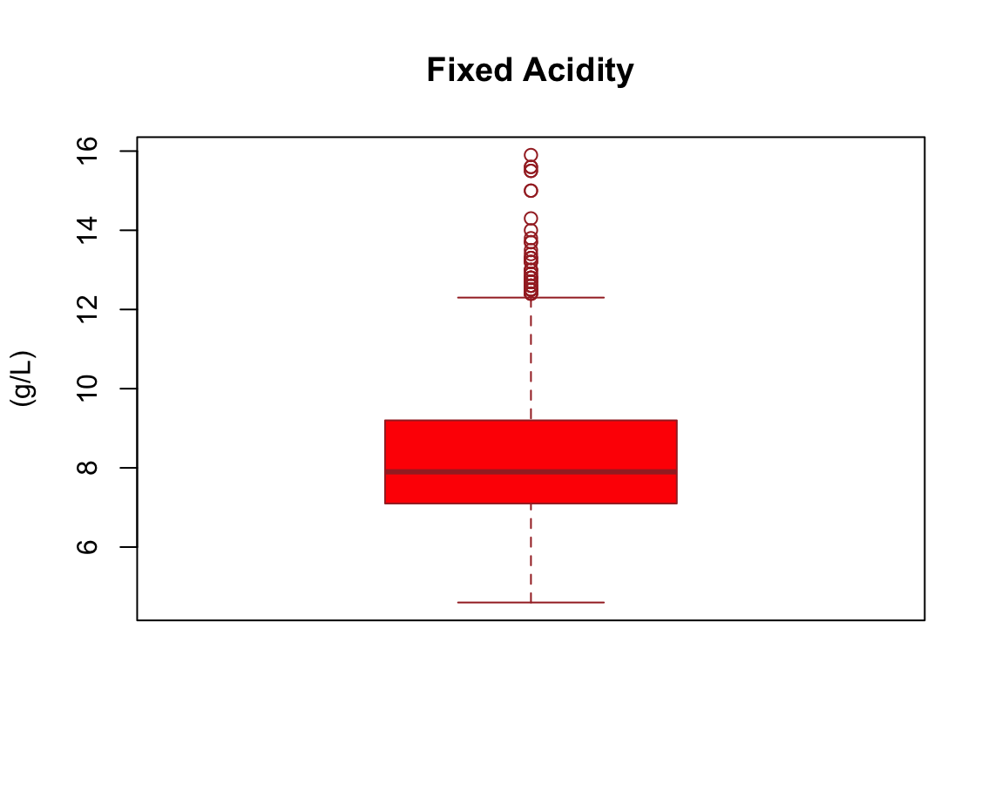
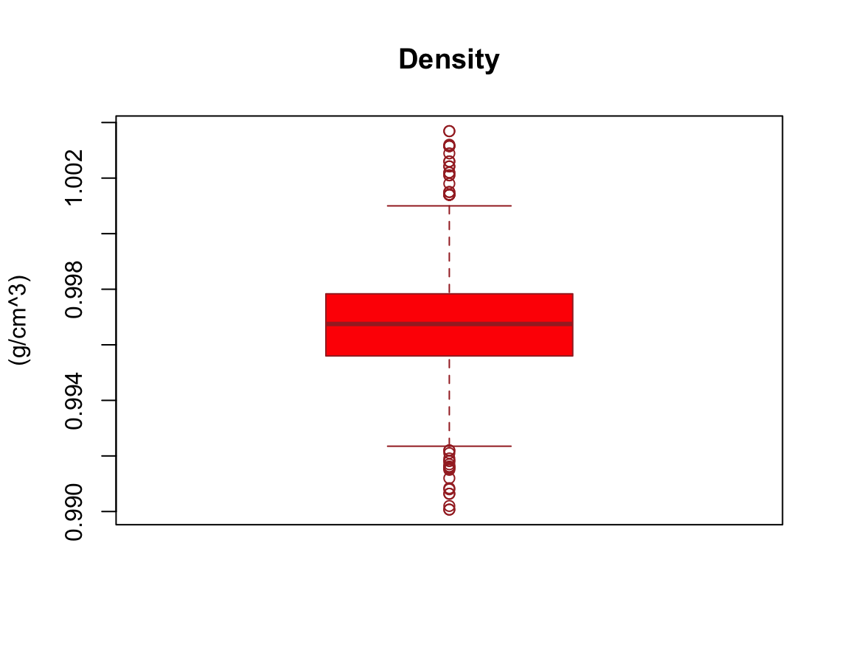
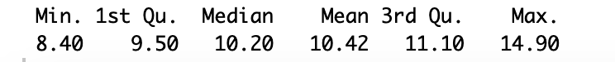
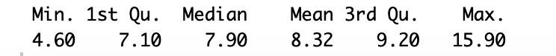
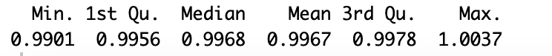
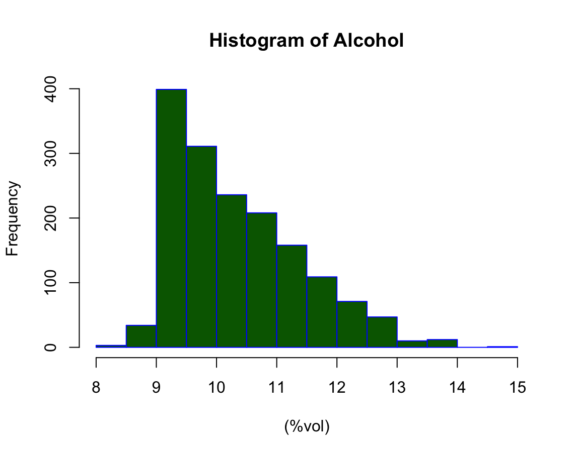
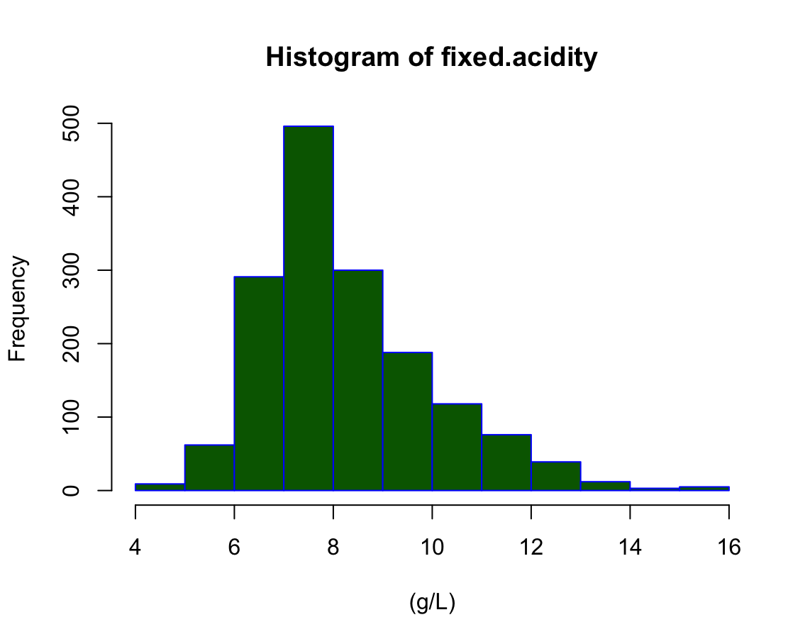
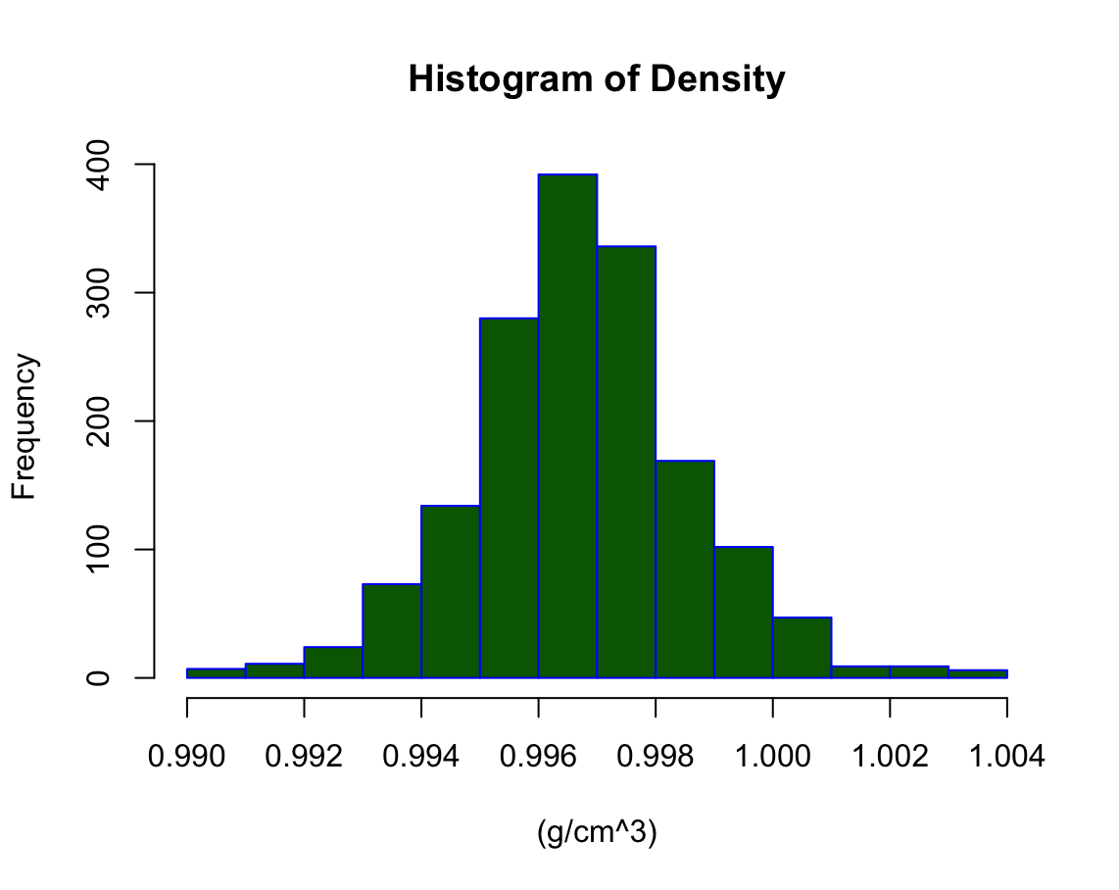

Slide 10
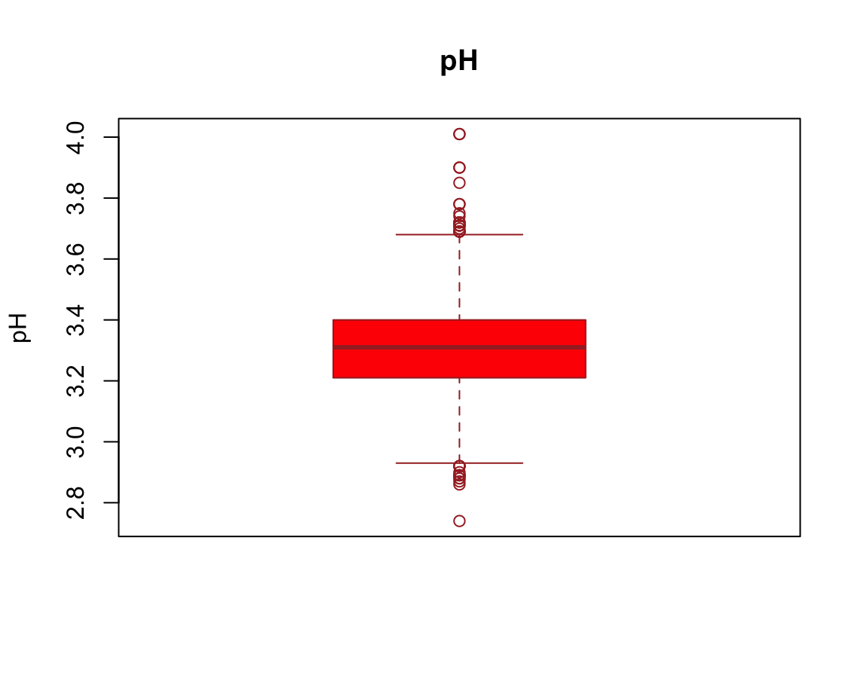
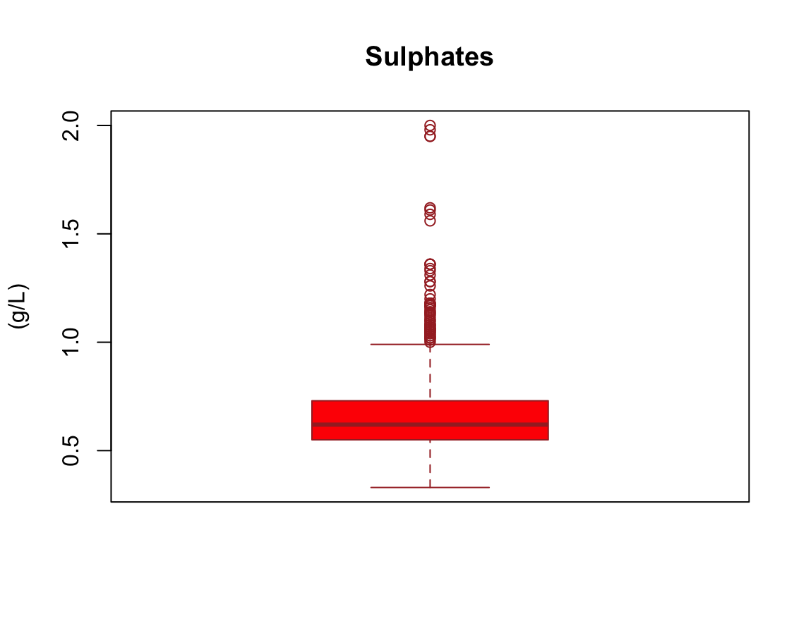
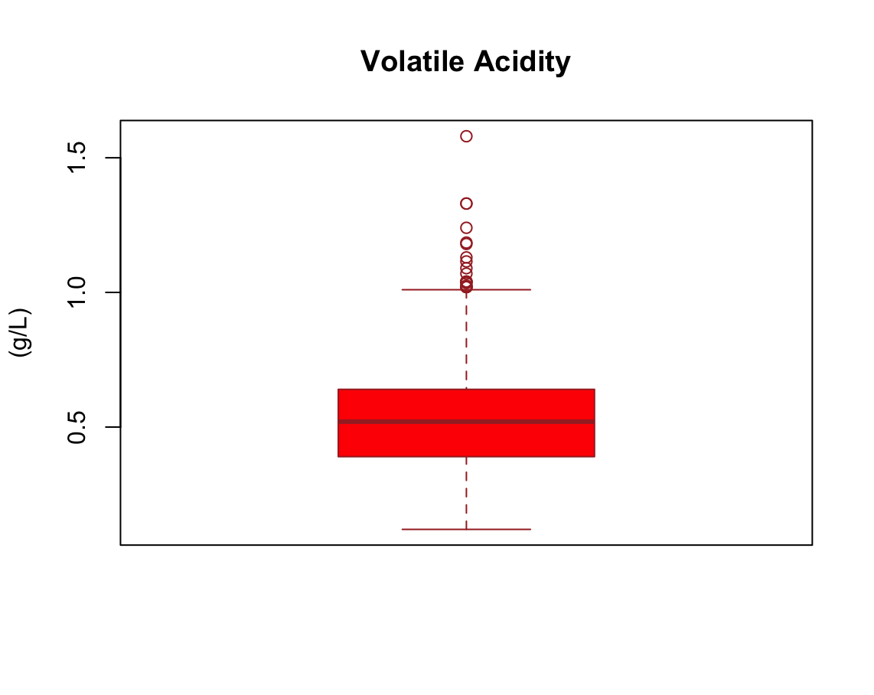
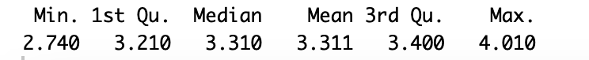
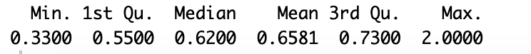
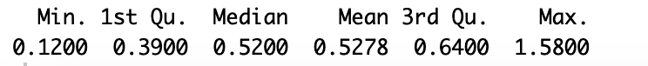
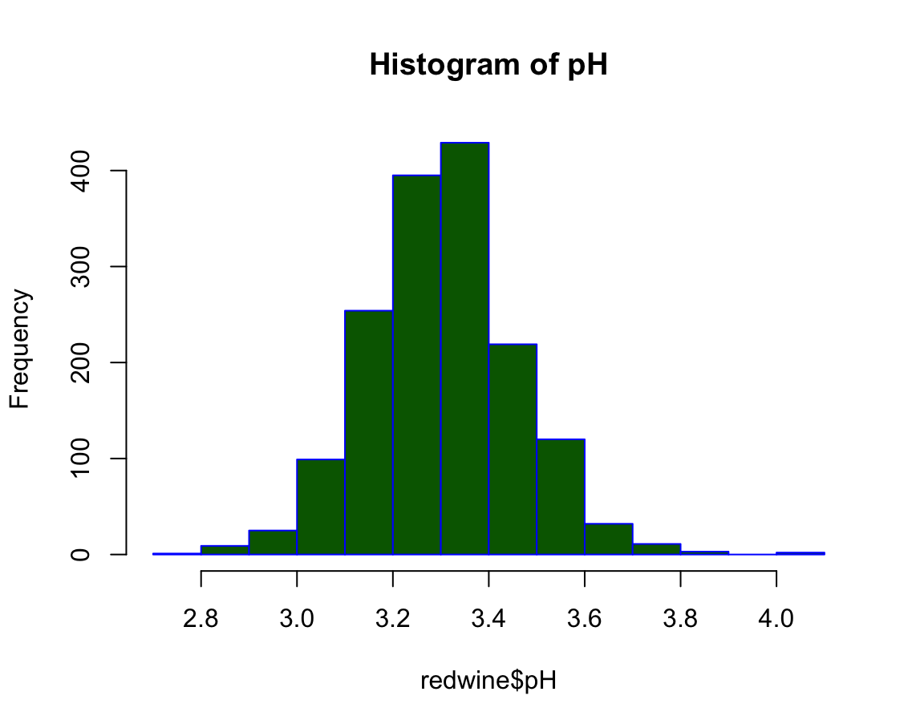
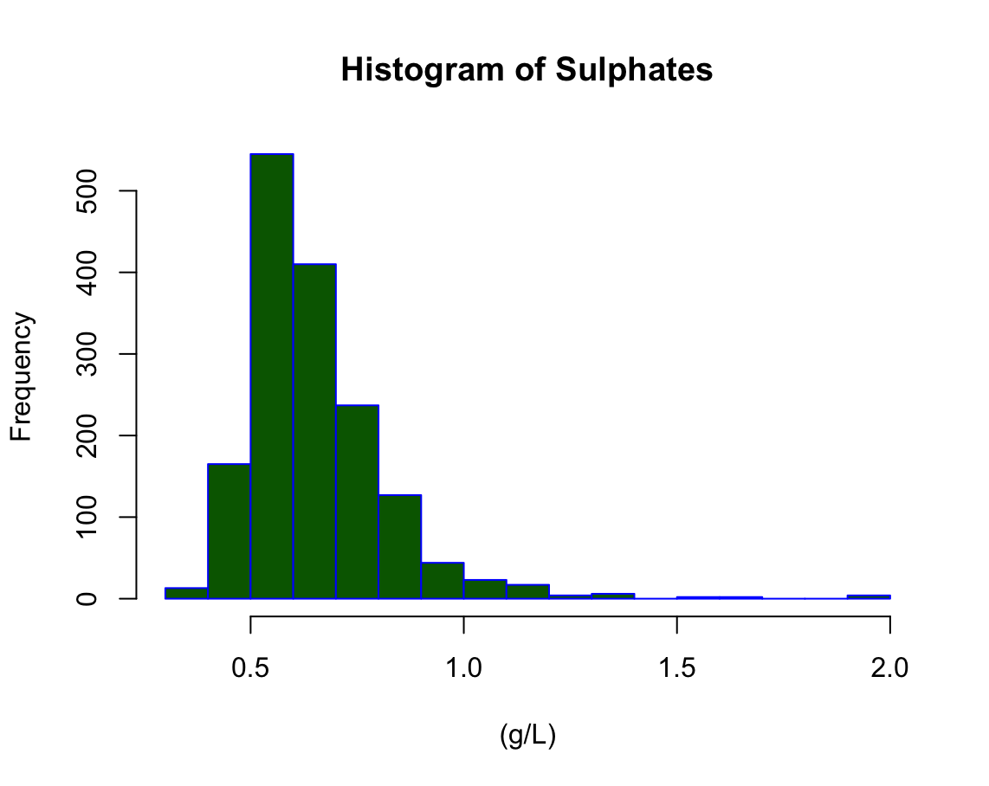
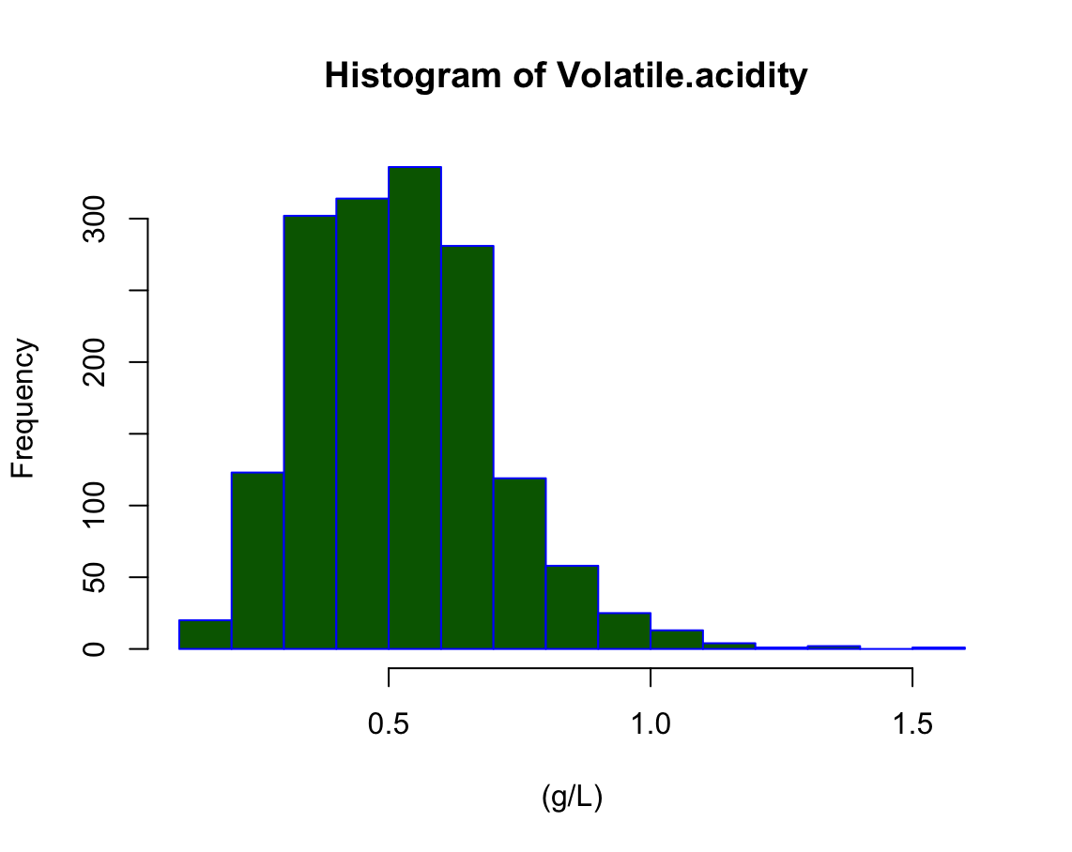

Slide 11
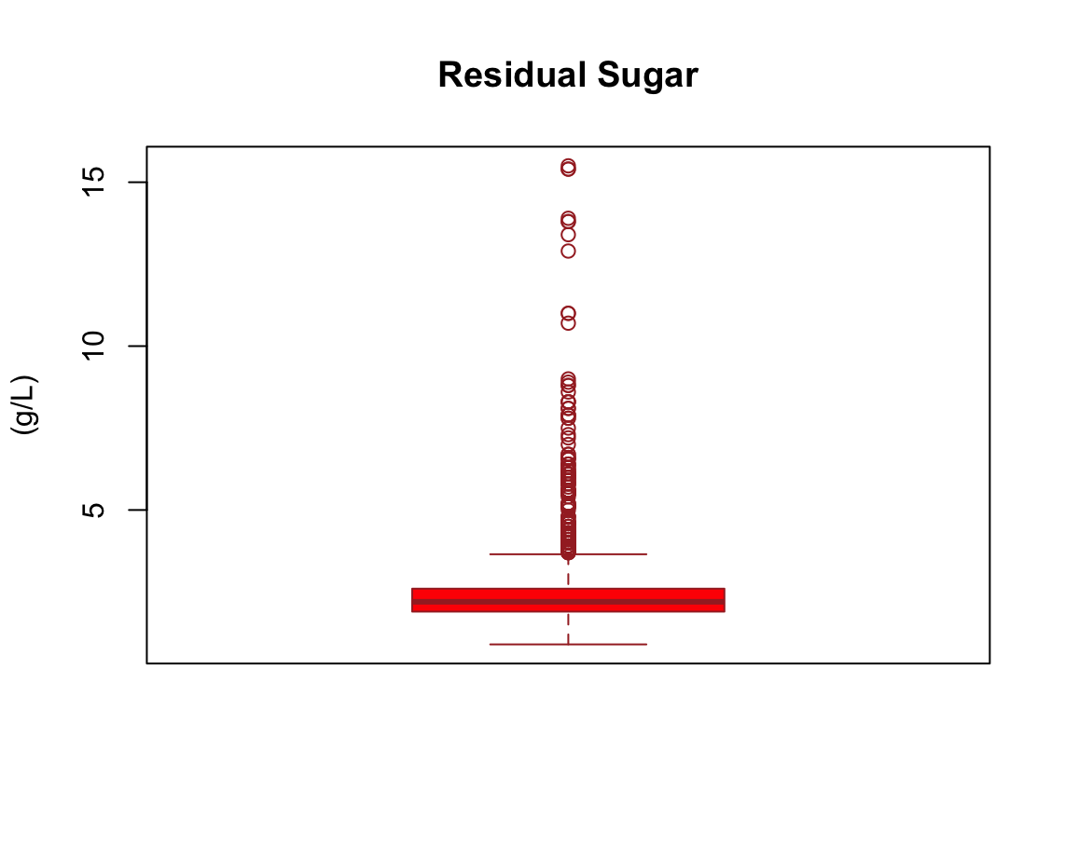
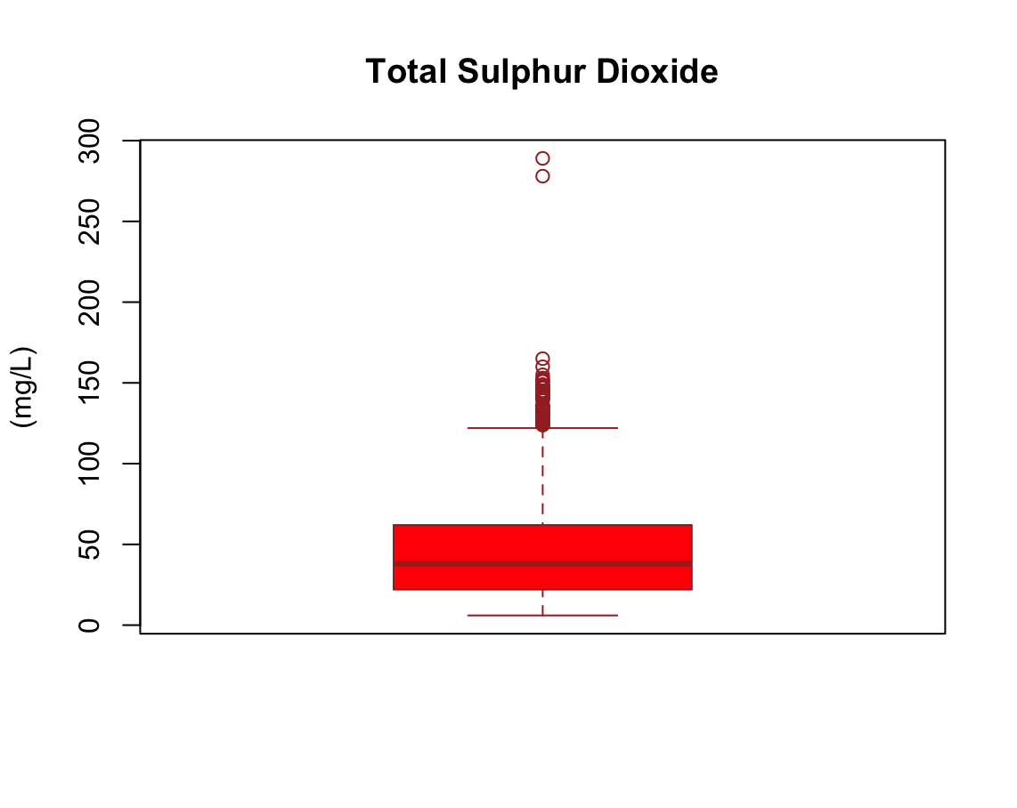
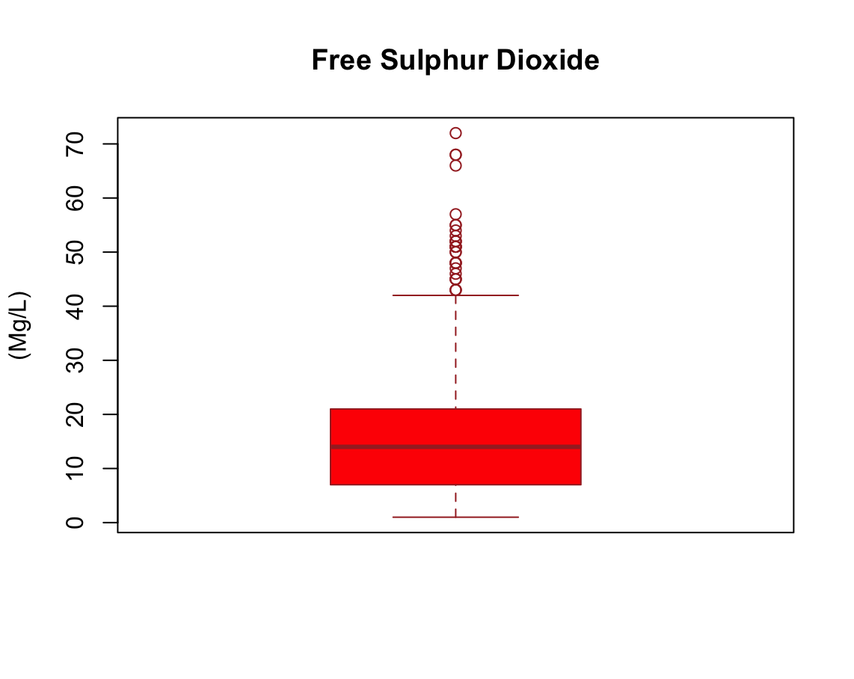
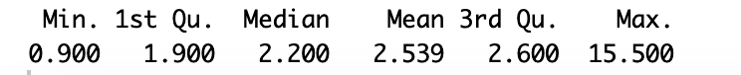
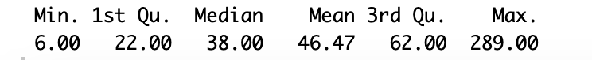
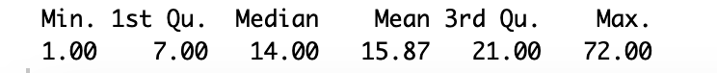
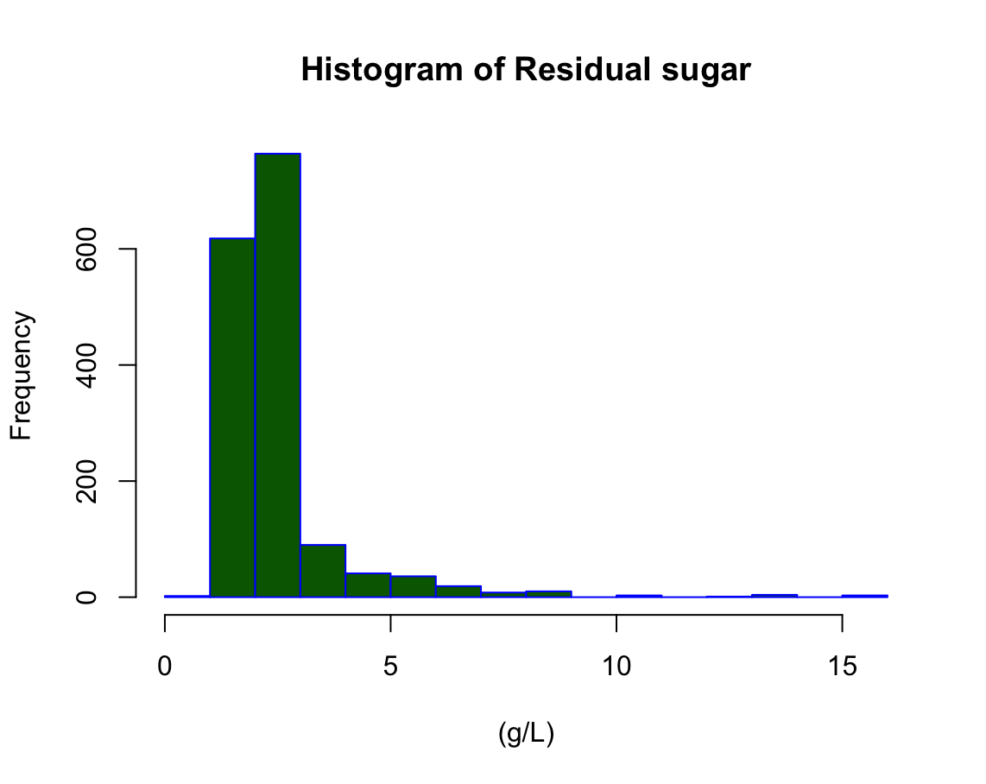
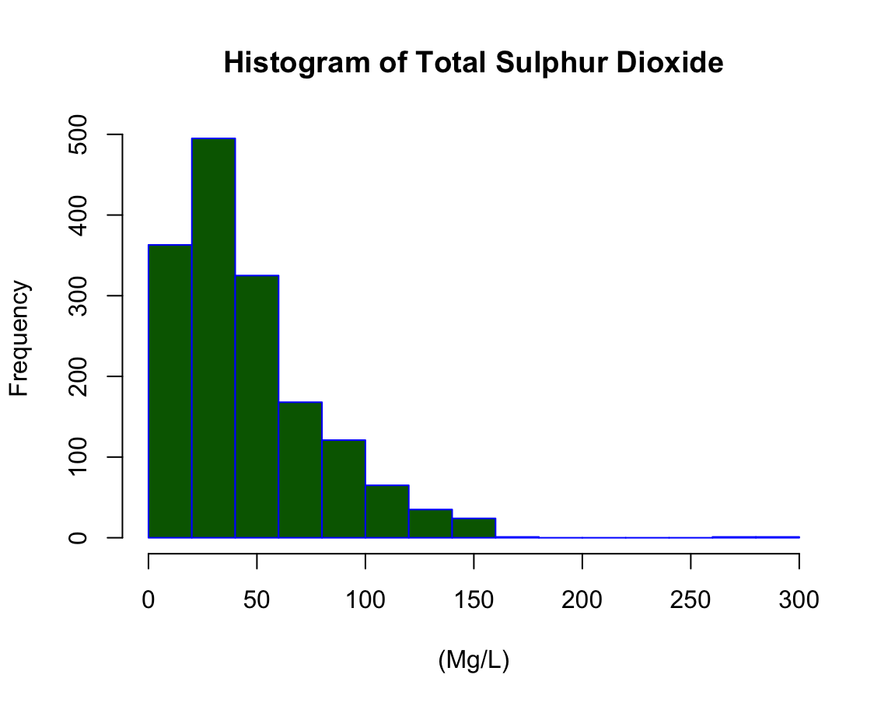
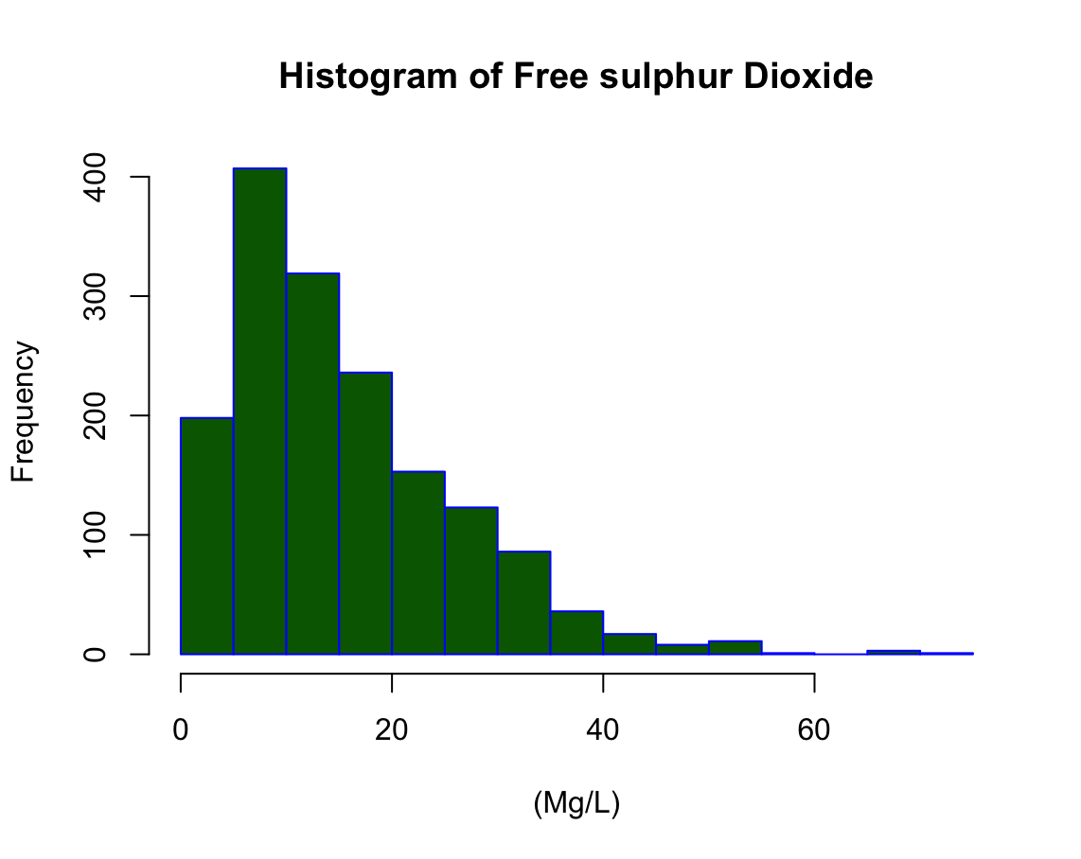

Slide 12
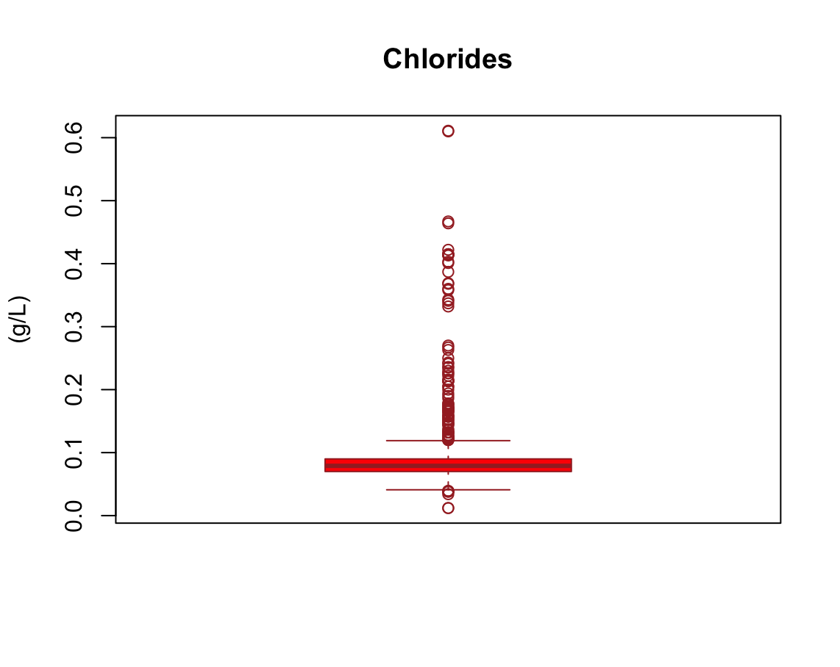
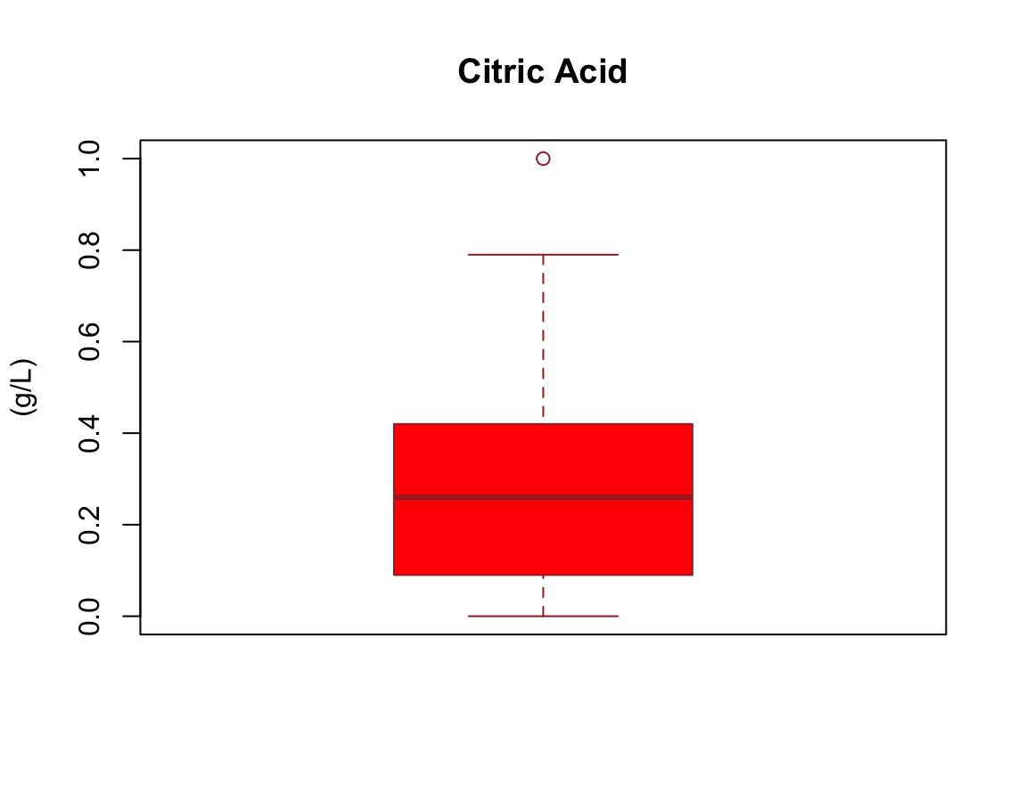
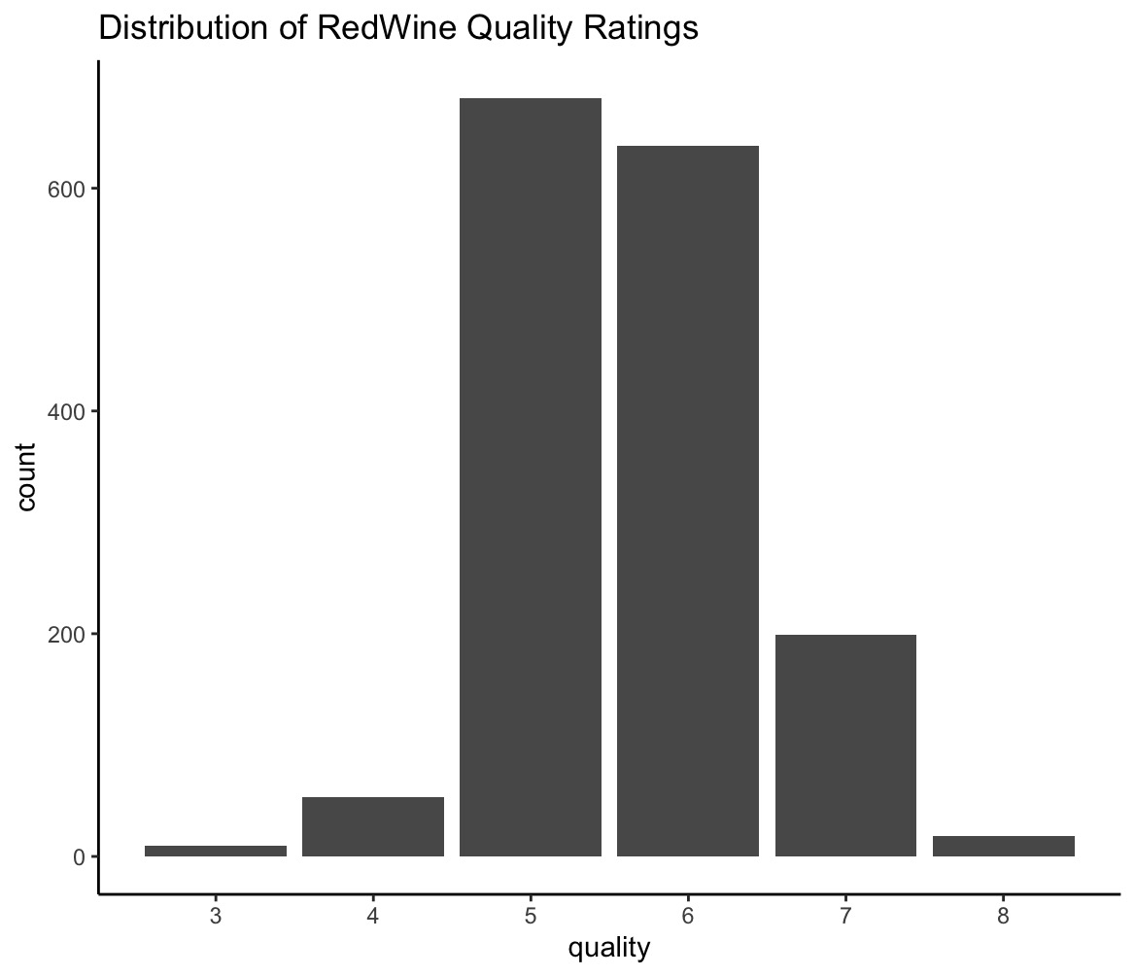
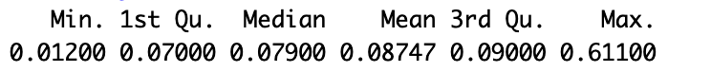
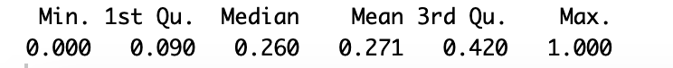
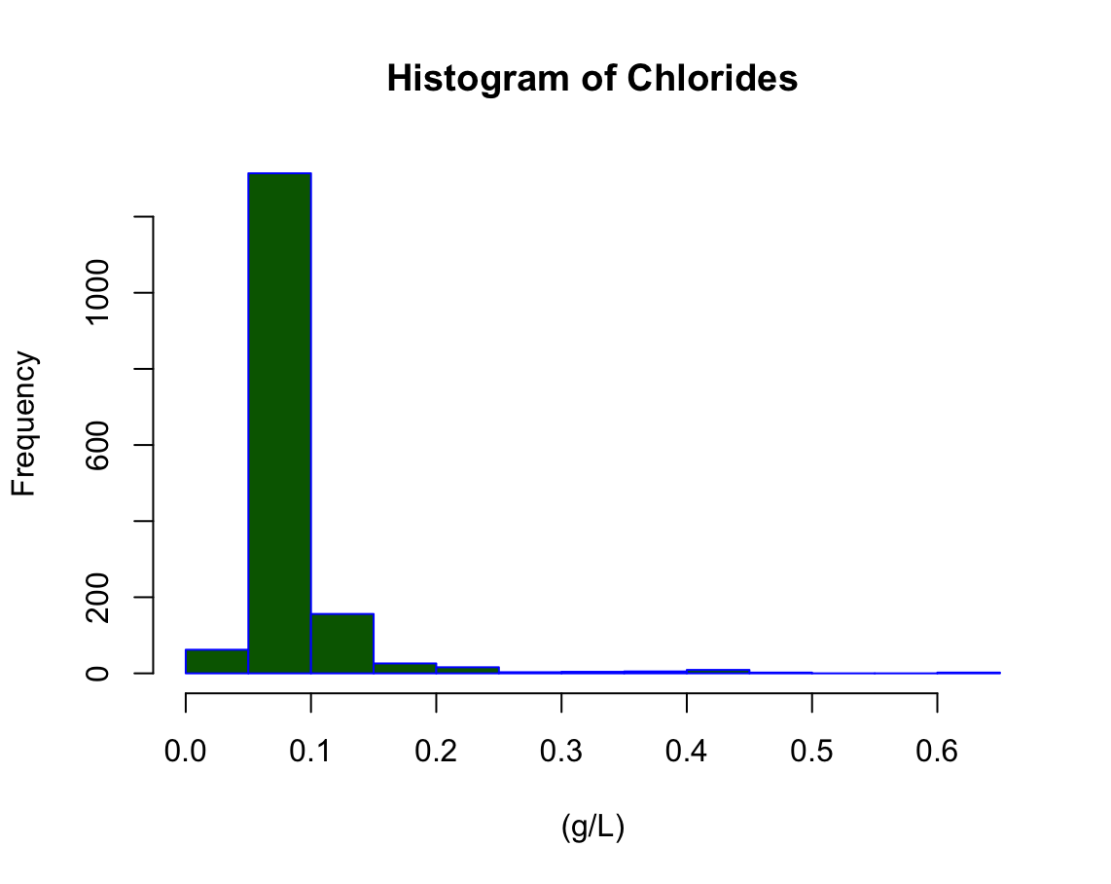
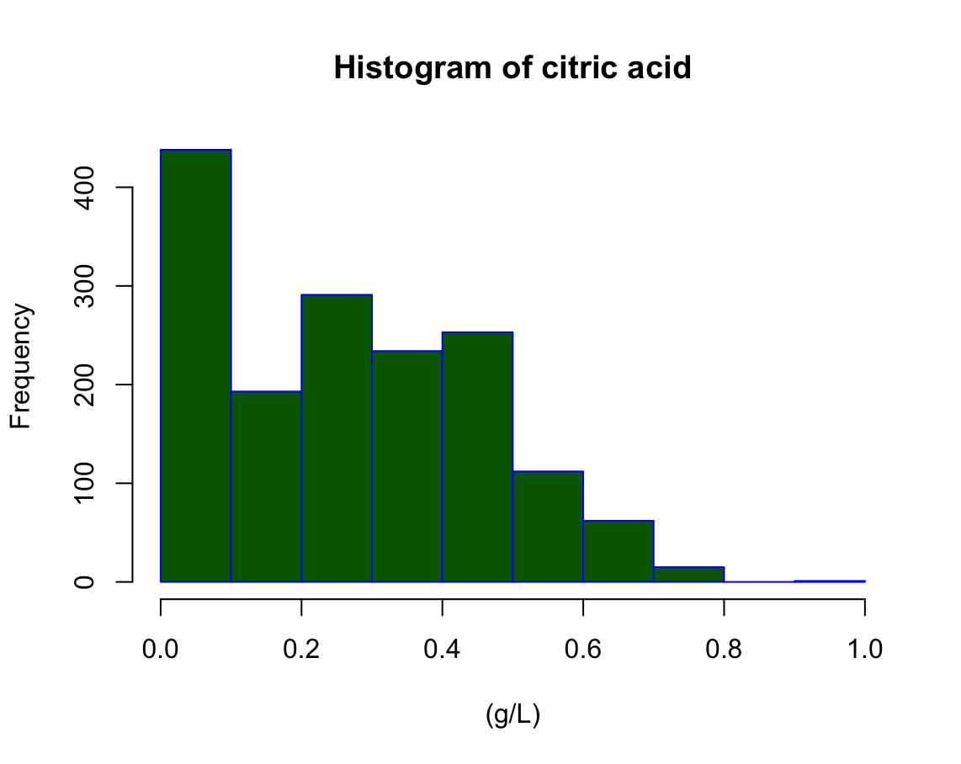
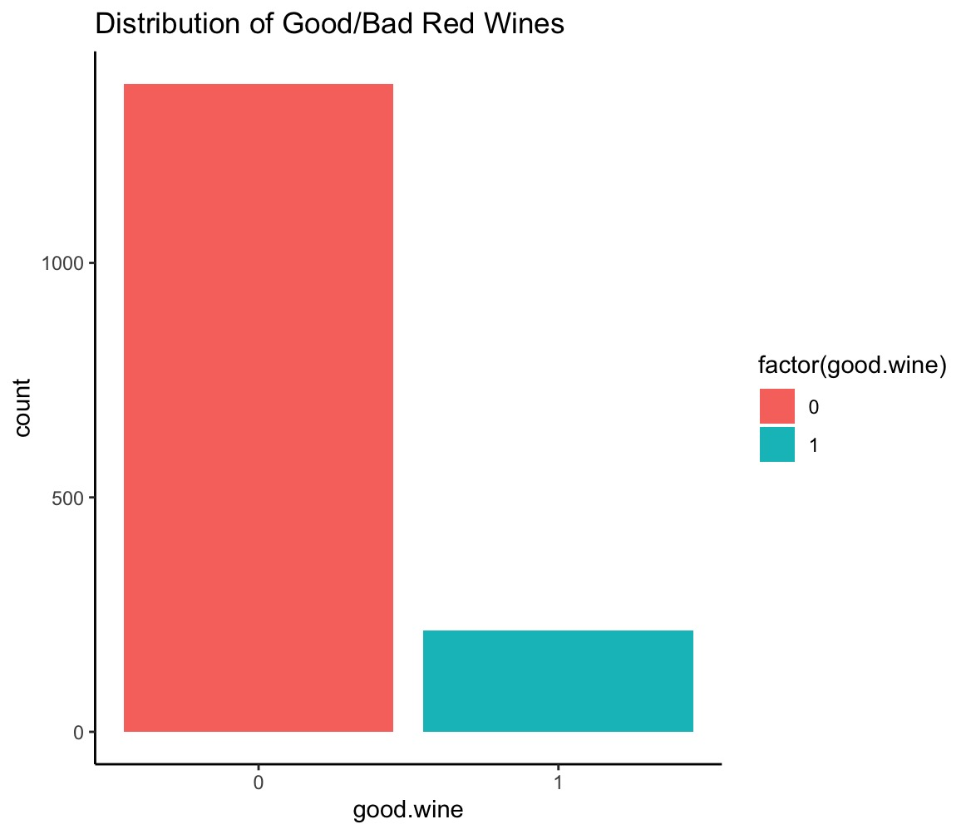

Slide 13
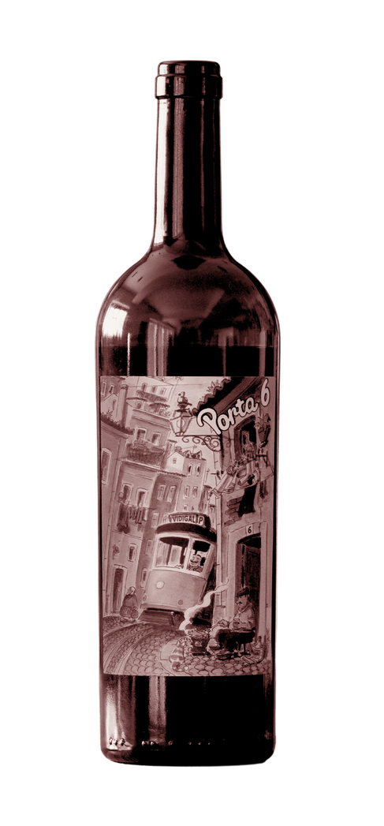
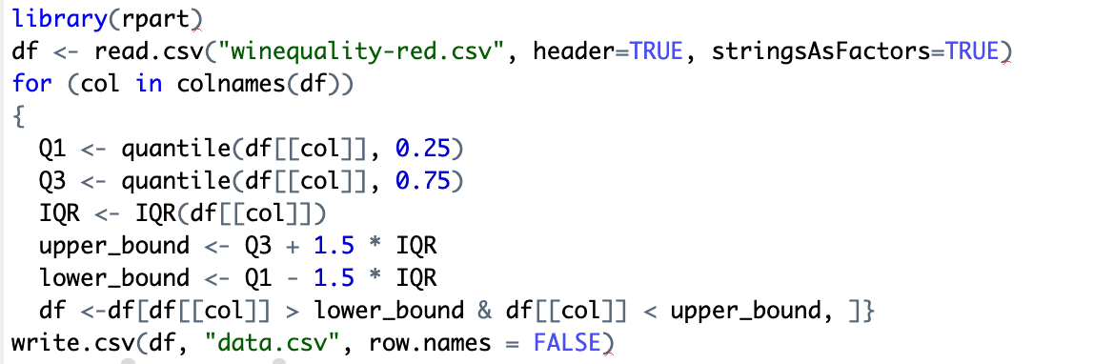

Removing Outliers

Slide 14
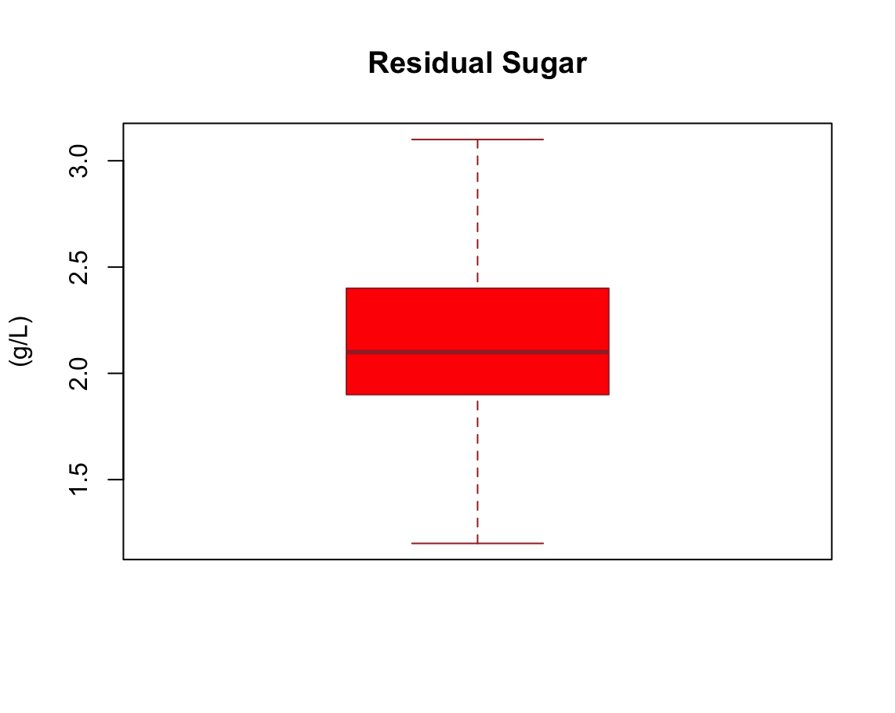
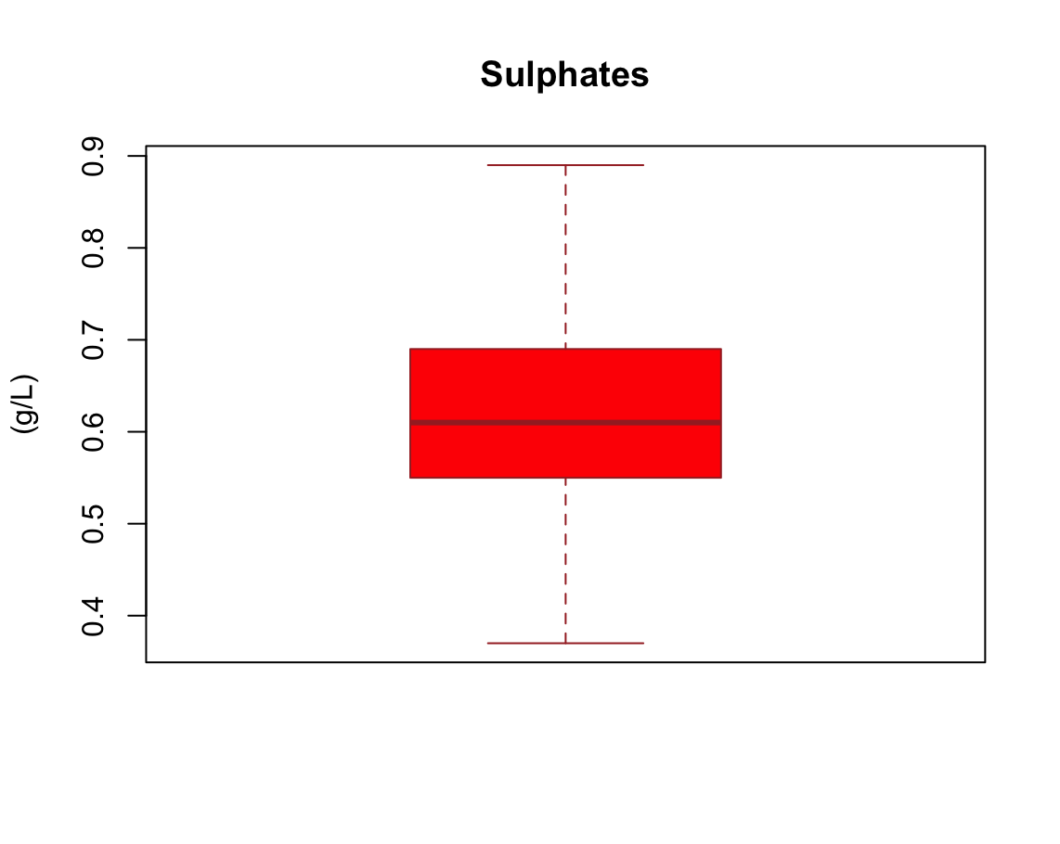
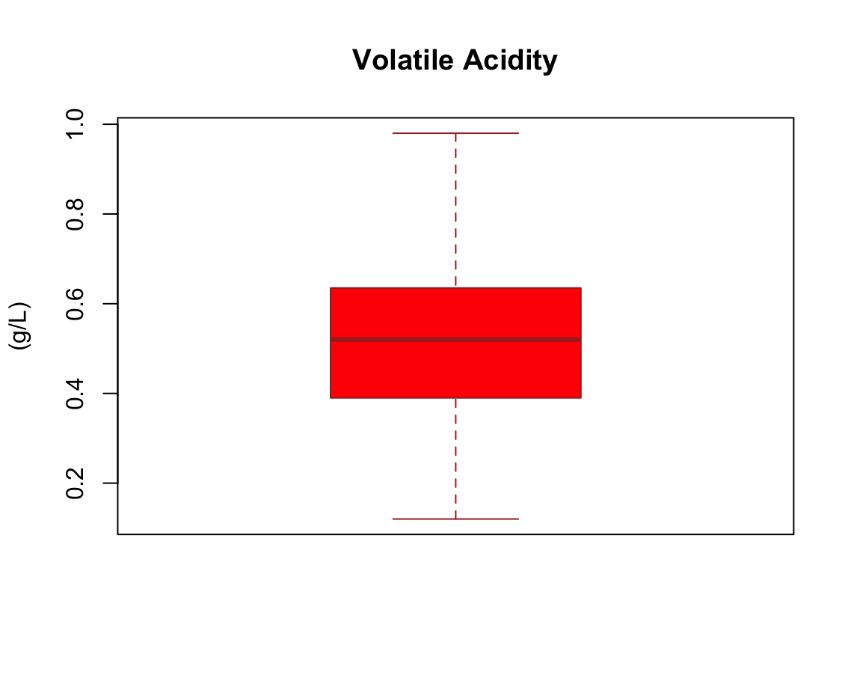
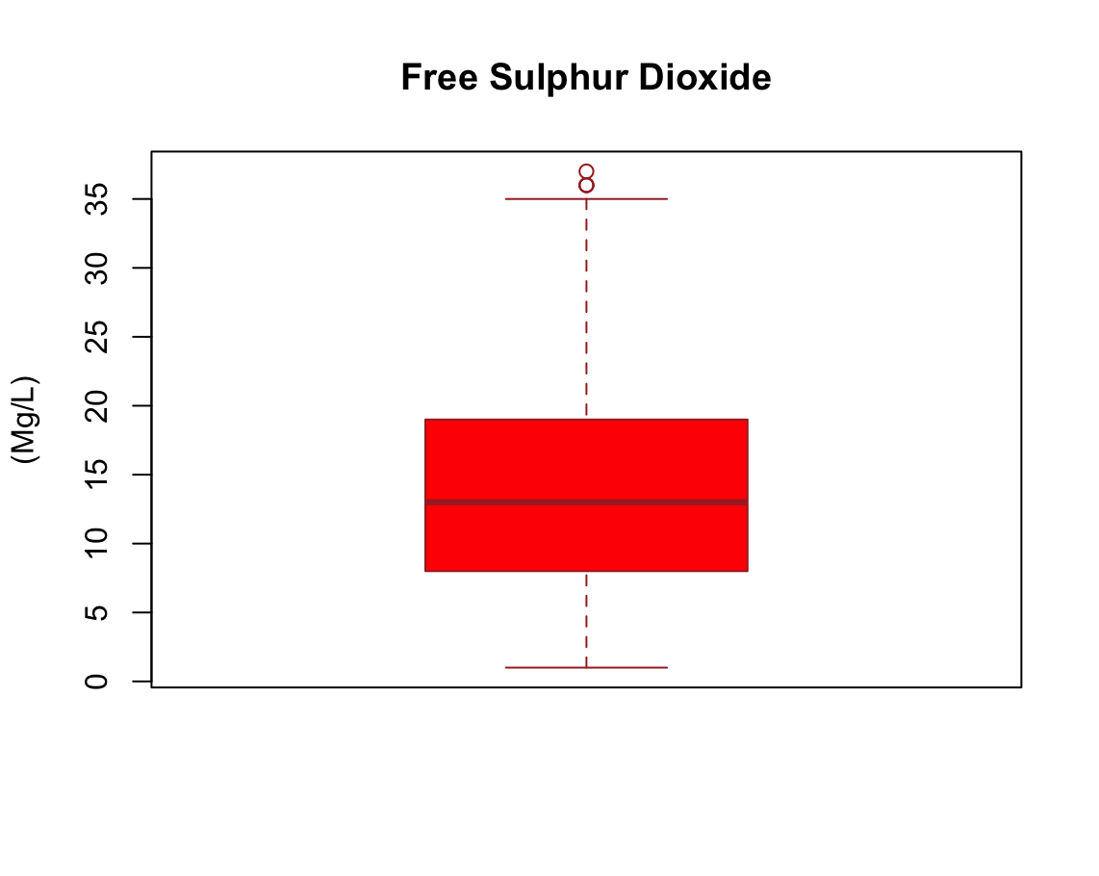
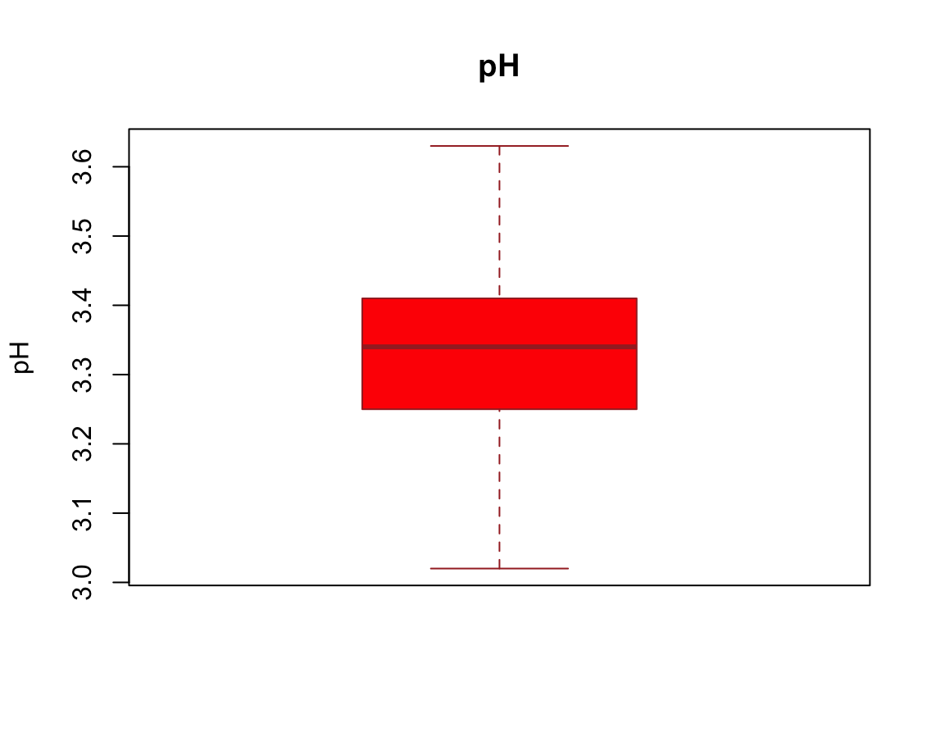
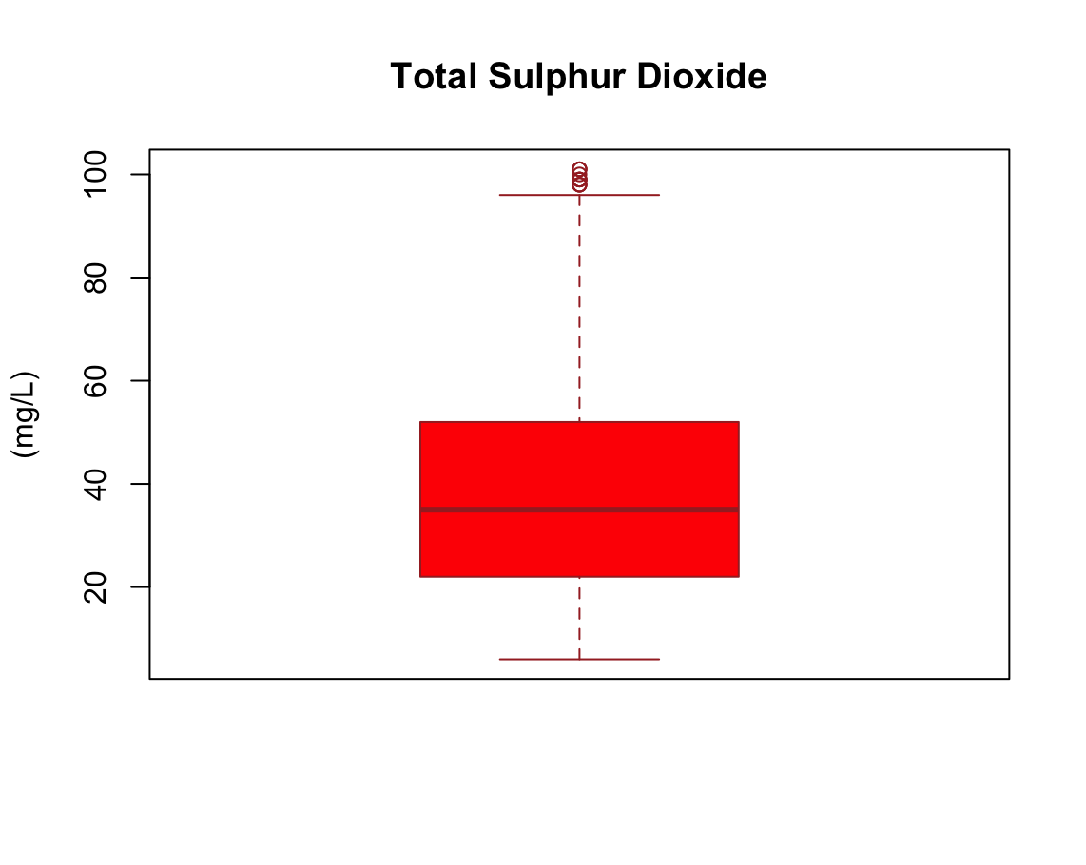
Cleaned Data

Slide 15
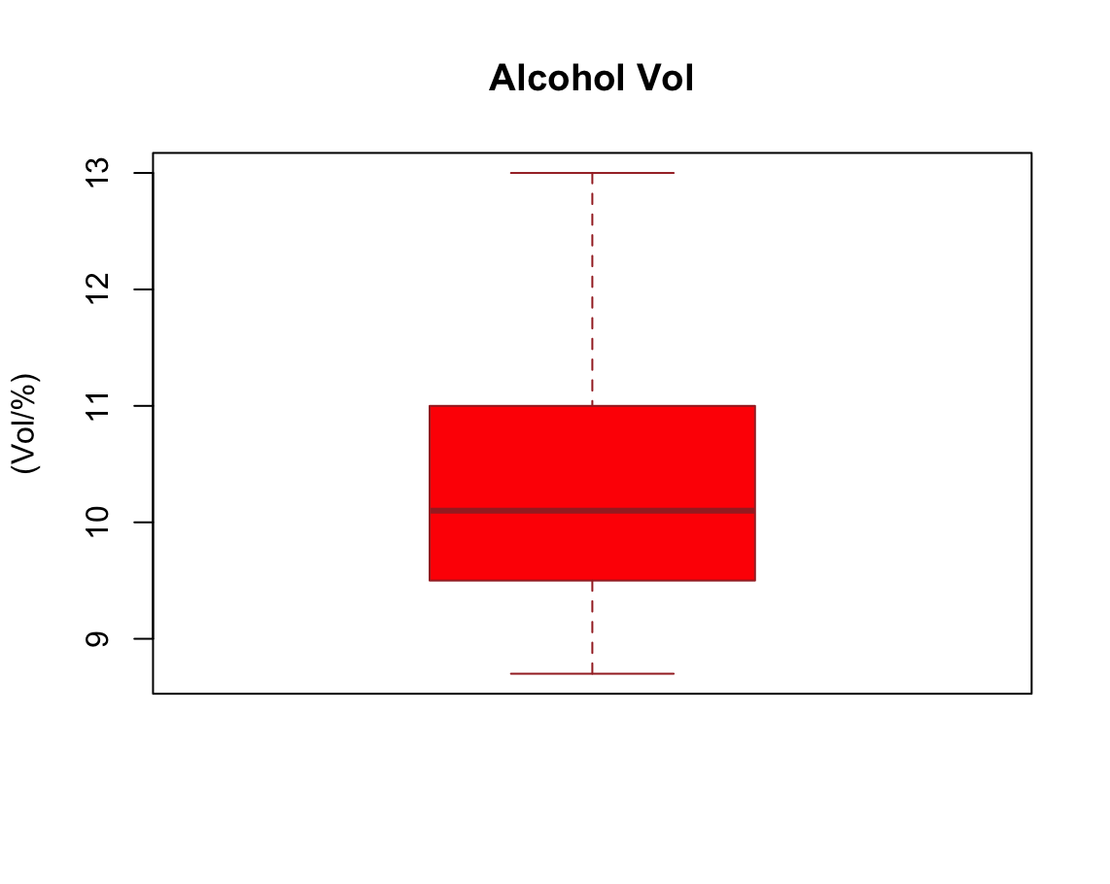
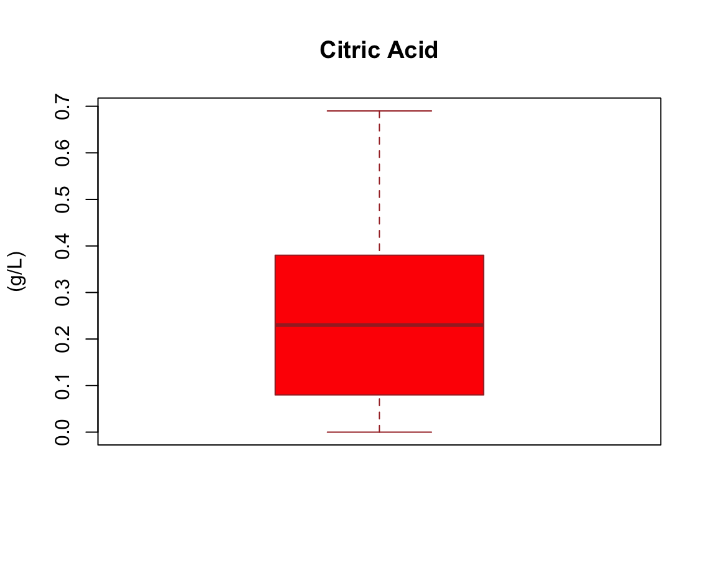
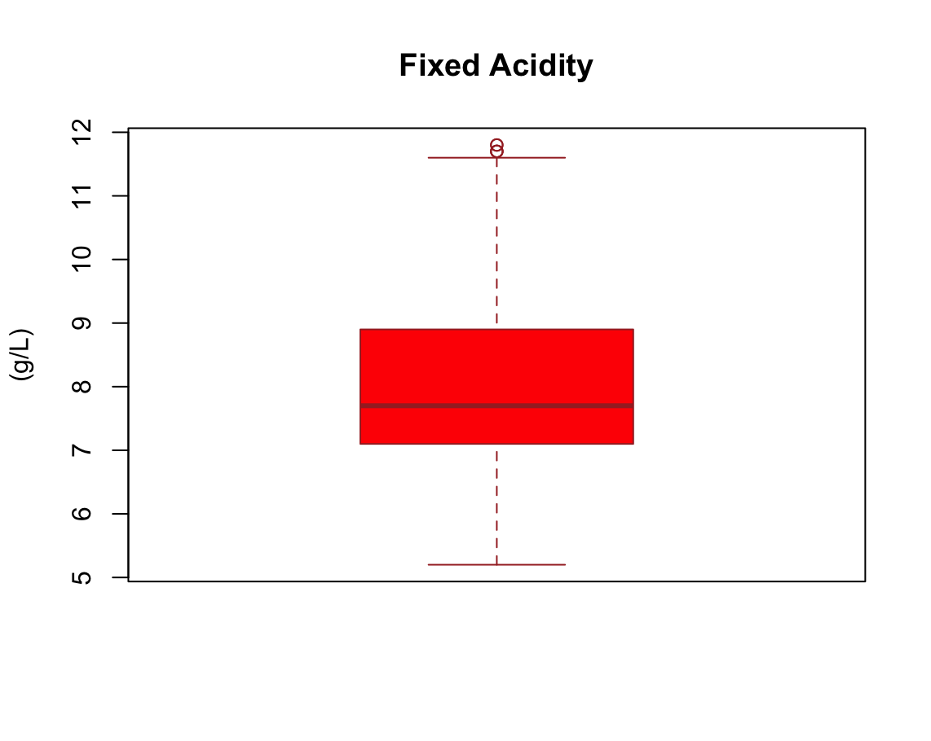


Cleaned Data

Slide 16


Correlation
As the heatmap suggests, alcohol has the strongest positive correlation with wine quality. Followed by citric acid and sulphates.
Residual sugar does not correlate with wine quality.
Volatile acidity has the strongest Negative correlation with wine quality. Followed by total sulfur dioxide and density.

Slide 17
DECISION TREE

Slide 18




Classification: Decision Tree
\

Slide 19


Model : Decision Tree
Alcohol Content: The first split separates data based on alcohol content (node 2). Instances with alcohol less than 10.15 (node 2) seem to have a higher proportion of class 5
Sulphates: Within the low-alcohol group (node 2), sulphates further split the data (nodes 4 and 5). Lower sulphates (node 4) seem to have a higher probability of class 5
Volatile Acidity: For high-alcohol wines (node 3), volatile acidity becomes a splitting factor (nodes 6 and 7).

Slide 20



Visualization: Decision Tree
Fruity

Slide 21





Performance: Decision Tree
TPR and TNR demonstrate the model's ability to correctly classify cancellations and non-cancellations.

Slide 22
LOGISTIC REGRESSION

Slide 23


Logistic Regression

Slide 24




Logistic Regression
Logistic Regression on Train Data
The Odds ratio for the model's attributes

Slide 25





Logistic Regression
Train Data Confusion Matrix
Test Data Confusion Matrix

Slide 26
FINAL TAKEAWAY

Slide 27


Final Takeaway
01
02
Variables affecting the quality of the wine:
Sulphates, Volatile Acidity, total sulphur dioxide, alcohol.
The model's performance on the test dataset closely aligns with its performance on the training dataset ,i.e, the model is not overfitting.

Slide 28
THANK YOU

